Slide 1
Breaking Prejudice
Do you know what we call opinion in the absence of evidence? We call it
― Michael Crichton, State of Fear
prejudice.”

Slide 2
OUTLINE
Consequences of prejudice
Interesting facts
Breaking prejudice
Definitions/Differences
2
4
6
8
Choose your apprentice
9
1
Grammar
3
5
7
Sources and origins of prejudice
Common stereotypes
Prejudice in the news
Quiz

Slide 3
Learning outcomes
By the end of the lesson , you will be able to;
Develop your social intelligence by recognising prejudicial attitudes.
Discuss the negative consequences of prejudice and the importance of empathy.
Use text evidence to build understanding of what is read.
Use modals to speculate and make deduction in the present.

Slide 4
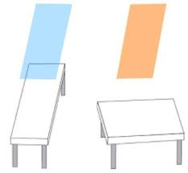
Have you ever wondered how you make decisions?
Take a look at these two tables...
Which one do you think seems longer?

Slide 5
Almost everybody selects the table on the left despite the correct answer being they are both the same length.
Are we inherently biased?
Unconscious biases influence our actions even when we don’t notice them.
Challenge your thinking, and recognize that you are inherently biased.

Slide 6
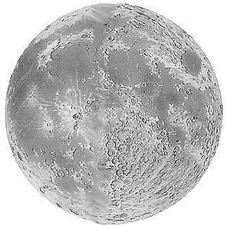

You are an entrepreneur,
You need to ‘hire’ an engineer to set up life on the moon!
It’s a big, challenging job that will make history.
It needs the right apprentice - someone with resilience, determination, engineering expertise and great people skills!

Slide 7
Choose your apprentice
The apprentices…
Fire one now so you have six remaining
Ali | Patrick | Jamie | David | Adriana | Hannah | Amadou

Slide 8
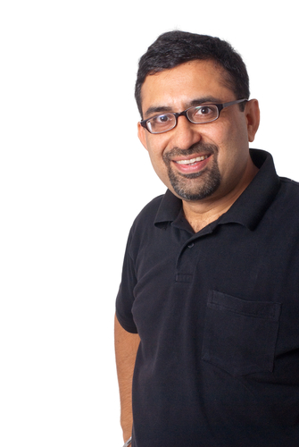
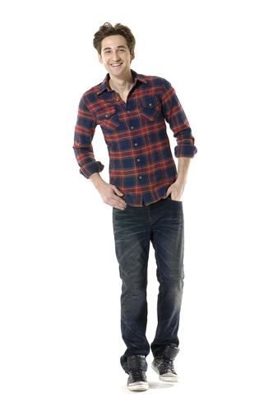
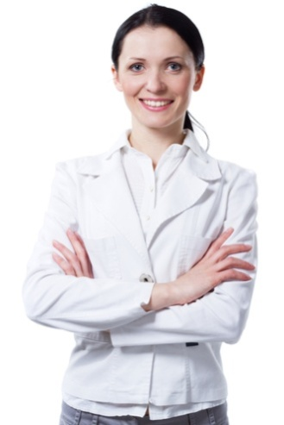
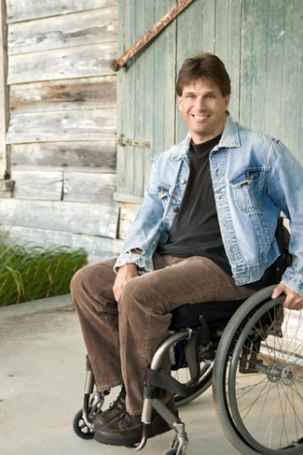
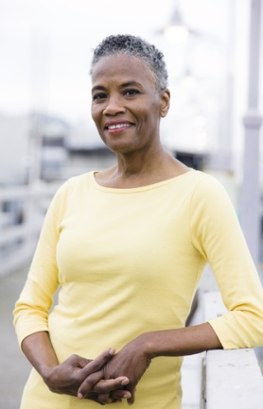
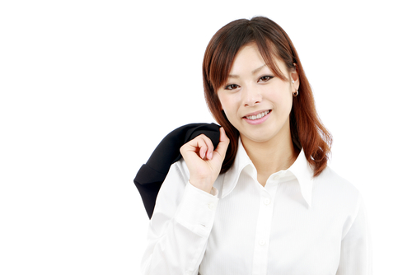
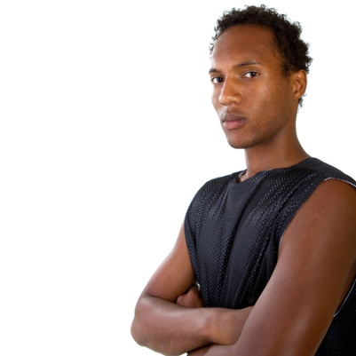
Choose your apprentice
Fire one now so you have five remaining
Ali Abdul
Patrick Murphy
Jamie Small
David Campbell
Adriana Carboni
Hannah Mann
Amadou
Bailey

Slide 9
Choose your apprentice
Fire one now so you have four remaining
Ali Abdul
Patrick Murphy
Jamie Small
David Campbell
Adriana Carboni
Hannah Mann
Amadou
Bailey
Physically fit but wears glasses
Physically and mentally fit
Physically fit and mentally fit
Physically disabled, mentally fit
Physically and mentally fit
Pregnant, physically & mentally fit
Physically fit but suffers anxiety

Slide 10
Choose your apprentice
Fire one now so you have three remaining
Ali Abdul
Patrick Murphy
Jamie Small
David Campbell
Adriana Carboni
Hannah Mann
Delroy
Bailey
Ex-Army
Entrepren-eur / business man
Firewoman
Doctor of engineering
Engineer and project manager
Army engineering officer
Engineer graduate

Slide 11
What choice did you make?
Would you have made a different decision if you had the qualifications information first?
What is wrong with judging people with such little information?

Slide 12
What do you think influenced your decisions?
Do you think people often judge people like this in our everyday life?

Slide 13
What is the difference between stereotypes, prejudice, and discrimination?

Slide 14
Prejudice: Preconceived judgment or opinion An adverse opinion formed without sufficient knowledge. An irrational attitude of hostility directed against an individual, a group, a race, or their supposed characteristics
Discrimination:
Refers to behavior. It can be direct, indirect or structural and often results from stereotypes or prejudicial attitudes.
Stereotype:
A widely held but fixed and oversimplified image or idea of a particular type of person or thing.

Slide 15
Stereotype: Cognitive
Categorization and labelling of individulas
Prejudice: Affective
Attidude (like or dislike) towards labelled individuals.
Discrimination: Behavioral
Eventually behavior towards individuals

Slide 16
Guess Prejudice or stereotype
Elderly people are wise
S
I disrespect boys who wear pink
P
All baby boys wear blue
S
Women enjoy shopping
S
I disrespect girls who play with a gun
P

Slide 17
The cycle of prejudice
Prejudice
They can’t
Stereotypes
They are
Discrimination
We won’t

Slide 18
What are the causes and origins of prejudice?

Slide 19
Sources of prejudice
Psychological
Social
Cultural
1
2
3

Slide 20
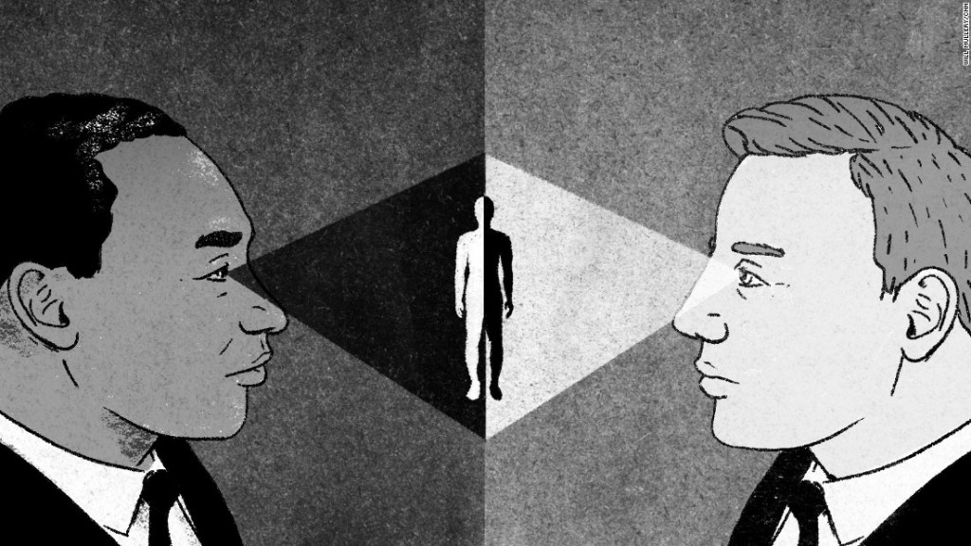
Psychological factors
Fear of the unknown, of something different, or the use of others to blame for one's own misfortunes.
In order to make sense of the world around us, it's important to sort information into mental categories.
Prejudice can develop from a person's feelings of insecurity and inferiority.

Slide 21
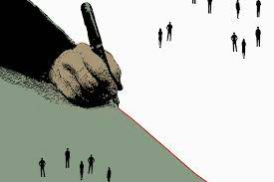
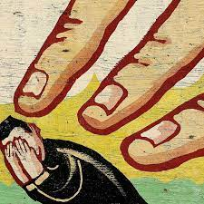
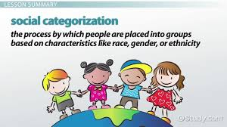
Social factors
Social inequalities
Scapegoating
Categorization

Slide 22
Cultural factors
Prejudice and discrimination are firmly rooted in our genetic heritage and are influenced by individual and cultural/historical factors and experiences.

Slide 23
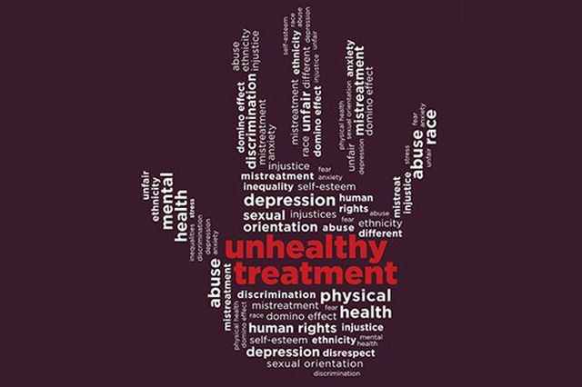
What are the consequences of prejudice?

Slide 24
low self-esteem
mental disorders such as anxiety, depression …
begin to believe negative stereotypes about themselves
feel like they lack control of their own life
experience issues at school and/or work (e.g. bullying, harassment, etc.)
start to lose hope in the future
experience loneliness and isolation
feel like they’re unable to trust others

Slide 25
What are the most common preconceived ideas?

Slide 26
The woman’s place is in the house Women can’t take leadership roles Blonde women are stupid Elderly people are frail and boring Immigrants are scroungers Boys that cry are effeminate

Slide 27
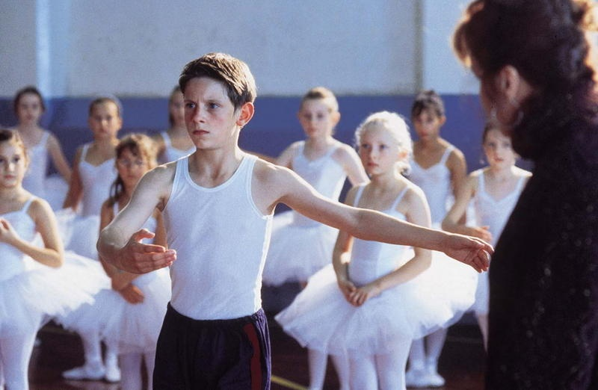
What is your reaction to this?
Notes:
27

Slide 28
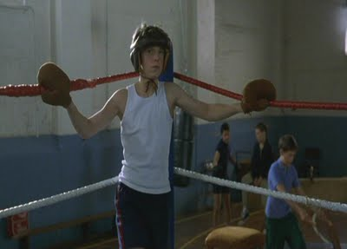
Does this seem better?
Notes:
28

Slide 29
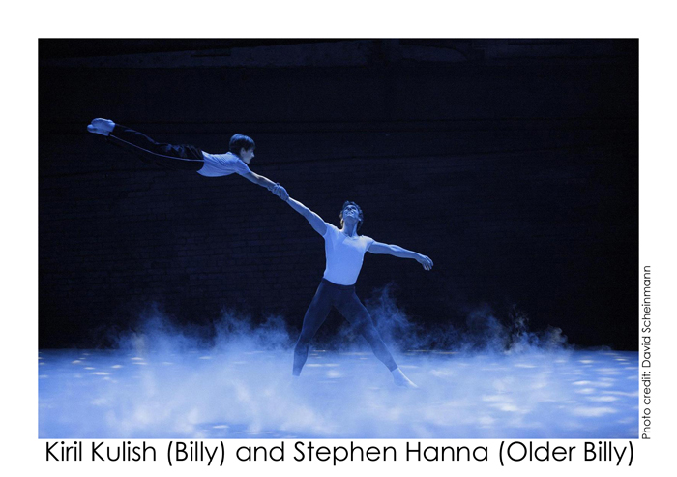
What is your reaction?
Billy Elliot was a boy who had a passion and gift for ballet, but he was forbidden to practice because it was for ‘girls’. He pursued his passion and became a successful ballerina, dancing in Swan Lake.

Slide 30
Why does Billy Elliot’s family not like him doing ballet?
Where does his family’s attitudes come from?
Are there certain sports that are for girls and others for boys?
Is it fair that some things are labelled as girls or boys?

Slide 31
Discussion point
As a child, what toys did you play with? Were these toy selections at all influenced by your parents, the media, or friends? Why or why not? Were these toys similar to or different from the toy you selected?

Slide 32
Interesting facts and statistics

Slide 33
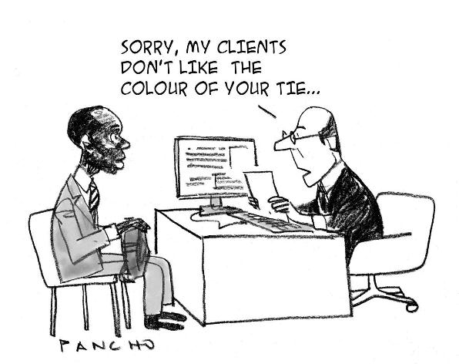
In New York City, 88% of police stops in 2018 involved Black and Latinx people, while 10% involved white people. (Of those stops, 70% were completely innocent.
On average, Black men in the US receive sentences that are 19.1% longer than those of white men convicted for the same crimes.
113 countries do not have laws to ensure equal pay for equal work among men and women
104 countries make certain jobs off-limits for women.
A total of 453 women, representing only sixteen percent of all presidents, now head U.S. colleges and universities.

Slide 34
• How and why does bias occur in news reporting?

Slide 35
Prejudice in the news

Slide 36
Read the news extract and highlight any evidence of prejudiced attitudes.
More than 7,600 viewers complained about racism on the reality show; Celebrity Big Brother. Viewers complained that the contestants of Big Brother were racially abusing the Bollywood star Shilpa Shetty. They claimed that Shetty, from India, was being victimised and bullied. Shetty, 31, broke down in tears after allegedly being taunted about her skin colour, accent and cooking.
What is the prejudiced attitude?
Indian people have funny accents and skin colour and eat funny food.
Who is the prejudice directed towards?
Shilpa Shetty and Indian people.

Slide 37
Read the news extract and highlight any evidence of prejudiced attitudes.
Sky Sports presenters Andy Gray and Richard Keys have been accused of sexism after making several comments about a female referee, called Sian Massey. They commented on her understanding of the offside rule during a Premier League match. The commentators believed their microphones were switched off but were actually recorded making remarks such as:
‘Somebody better get down there and explain offside to her.’
‘Can you believe that? A female linesman. Women don’t know the offside rule.’
What is the prejudiced attitude?
Women don’t know the offside rule or understand football
Who is the prejudice directed towards?
Sian Massey and women

Slide 38
What are the implications of biased news reporting, particularly for marginalized groups?

Slide 39
Quiz
1. Imagine a person holds a very strong, emotional antipathy towards members of a different social group. This person really hates these out-group members. This is best classified as an example of which of the following?
Discrimination
Prejudice
Stereotyping
2. Which emotion makes people stereotype relatively more?
Anger
Sadness
Both
Neither
3. Which of the following is the best example of prejudice?
The owner of a company evaluates all potential employees exclusively by their professional qualifications.
The exaggerated and oversimplified belief that a majority of lawyers are dishonest.
A man from Cancun, Mexico does not like Americans because he thinks they all drink irresponsibly.
A woman believes it will rain because she sees many grey clouds in the sky.

Slide 40
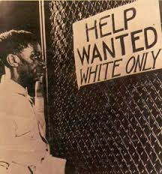
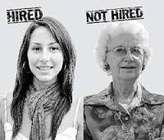
4. Denying or restricting the rights of a person due to their membership in a certain group is an example of _____.
Discrimination
Persecution
Prejudice
Stereotype
5. This photo is an example of
Discrimination
Stereotype
Prejudice
6. What is this picture suggesting?
Prejudice
Discrimination
Stereotype
All of the above

Slide 41
The scary thing about unconscious biases is they affect us all, and we can be oblivious to their power. They are formed by the culture that surrounds us – environment, media, stories and language all influence how we think and behave toward a particular group of people.
To demonstrate this, take a look at this old riddle.
A father and son are in a car accident. The father dies at the scene and the son, badly injured, is rushed to hospital. In the operating room, the surgeon looks at the boy and says, “I can’t operate on this boy. He is my son”.
How can this be?

Slide 42
If your immediate reaction is puzzlement, it’s because your unconscious mind has tricked you to think ‘male’ on reading surgeon. The association that surgeon equals male is part of a stereotype. A glitch in your brain prevented you from figuring out that the surgeon must be the boy’s mother.
About 40% of people make this mistake when presented with the riddle.
This is prejudice, and it is often wrong.
We don’t see things as they are we see things as we are.

Slide 43
How can we prevent making biased judgments about others?

Slide 44
Reflect on your own ideas and actions to see if you have prejudiced attitudes or act in discriminatory ways (either on purpose or unintentionally)
Challenge peers/family who express prejudiced beliefs
Support organizations that help address the root causes and effects of stereotypes, prejudice and discrimination
« Could a greater miracle take place than for us to look through each other’s eyes for an instant? »
Henry David Thoreau
Develop an empathetic attitude

Slide 45
Breaking the cycle of prejudice
Prejudice
They can’t
Question values on which policies they are based on
Question assumptions
Discrimination
We won’t
Stereotypes
They are
Act contrary to expected stereotype
Reaction
Reacting to situations one cannot control
Victim
Offender

Slide 46
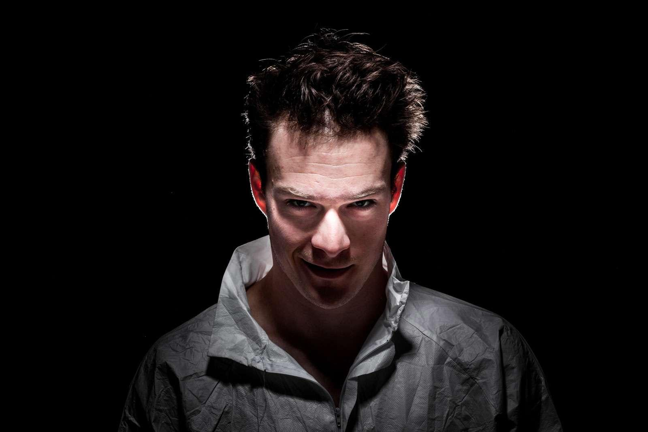
To wrap up
Prejudice
Unreasonable feelings, opinions, or attitudes, especially of a hostile nature, regarding an ethnic, racial, social, or religious group.
He can’t be a doctor.
He must be inferior.
He might be a psychopath:
Modals of deduction in the present

Slide 47
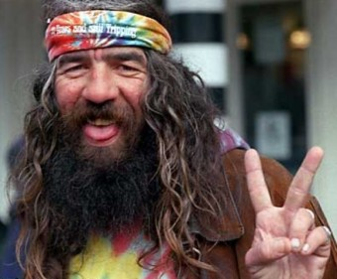
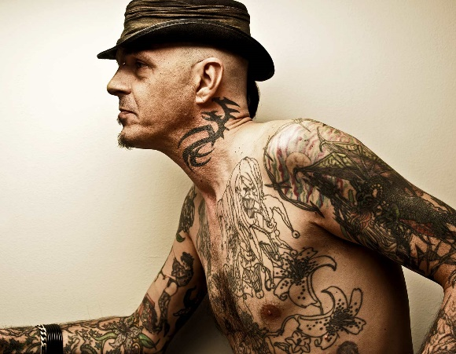
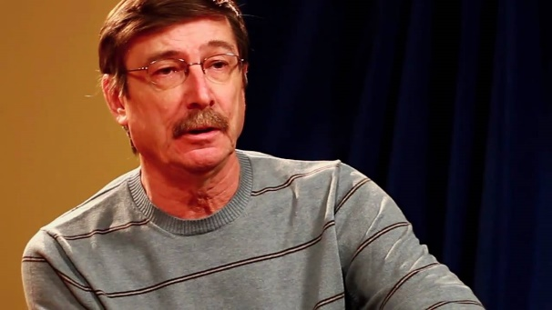
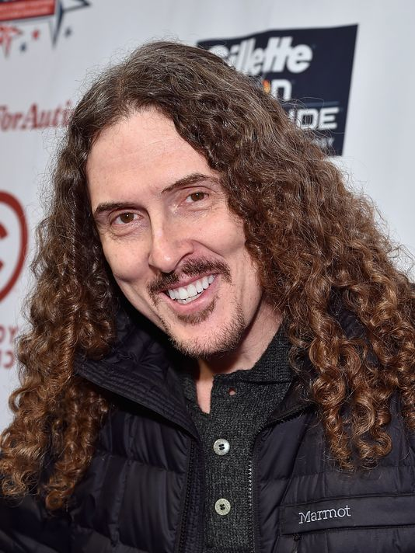
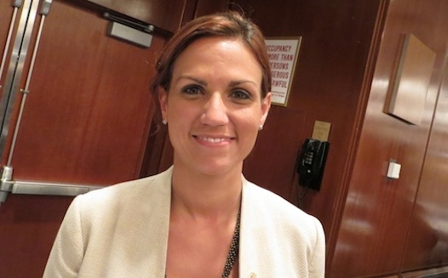
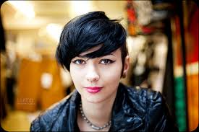
Grammar
Make speculations about these people. Decide which person has which job.
A lawyer/ A police officer
A serial-killer /A billionaire
A rock star / A bank robber
A chef /A professional sports-person

Slide 48
Possible answers
might/may/could be
He/she … a rockstar (possible)
There’s a chance that he’s… (possible)
He/she … a police officer (impossible)
There’s no way he’s… (impossible)
He/she be a lawyer… (almost certain)
I’m pretty sure he’s… (quite certain)
can’t be
must

Slide 49
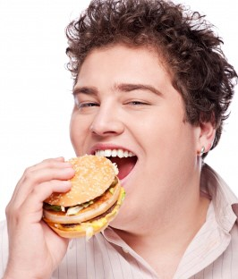
Modals of deduction
Deductions: guesses based on known facts.
Must be = very sure it’s possible 99 %
Can’t be = very sure it’s impossible 99%
He can’ be a vegetarian.
May (Not) /Might (Not)/Could be =We think it’ possible 50%
Certainty in the present
Possibility in present / future
We can only use could in the positive form, not the negative form, for talking about possibility:
Are you sure that’s a good idea? The boss may not / might not like it when he finds out. The boss could not like it when he finds out.
Possibility in the present/future

Slide 50
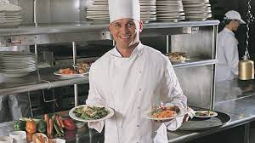
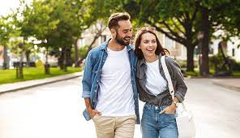
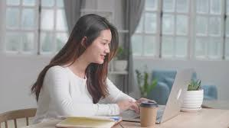
Let’s practice: how many deductions can you make?
He must be a chef.
He can’t be a policeman.
He may/might/could be famous.
They must be friends.
They can’t be working.
They may/might/could be married.
She must be at home.
She may/might/could be working

Slide 51
Let’s take a quiz! Choose the correct modals of deduction to complete the sentences.
1. 'Where's Kim?' I'm not sure. Try her office - she _____ be in there.'
can might must
2. 'I'm starving! What's for dinner, Mum?' 'Fish.' 'I hate fish! I'm not eating it.' 'You ____________ be very hungry, then.'
mustn't couldn't
3. 'Look. Simon's given me a present. What do you think it is?' 'It ___________ be perfume, I suppose. It's about the right size.'
must can could
4. 'What kind of bird is that?' 'I'm not sure. It __________ be an eagle but I can't see it very well.'
must might can't
5.'Whose bag is this?' 'It __________ be Mike's. It's on his desk.'
must might may

Slide 52
6.'I'm worried about Grandma. I tried to call her but she's not answering her phone.' 'She _____________ be out. Or she might be asleep - she sometimes has a nap in the afternoon.'
may
can
must
7. 'There's someone at the door.' 'It ____________ be John. He just called to say he was coming.'
could
may not
must
8. That man ______________ be Tim's father - he looks just like him.
couldn't
mustn't
must

Slide 53
Thanks!
Any questions?

